Slide 1
MINI PROJECT Time Series - Furniture Sales Forecast
By,
B.Jagadhesh,
DSFT8

Slide 2
Furniture Sales Forecast :
Every business owner’s objective is to estimate the future trends – in terms of sales, profits, gains etc.To do this analysis, the owner first has to segregate the data by category and analyze each entity separately. For each entity, a forecast can be estimated based on the past sales of that entity. The idea behind this is to find out the popularity of a certain product and how its sales can impact the business.
Every product category is unique and cater to different customer base. So the analysis cannot be generalized that one trend is applicable to all products. A thorough insight into the past performance will reveal a lot of components that will enable the business to identify the trends.
Business Objective :
Build a forecast model to predict the furniture sales of a certain store

Slide 3
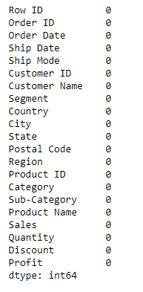
Data Set :
The given data has 9994 Rows and 21 Columns.
This is time series project and we to predict the sales for the category Furniture.
There are no null values in the given data.
We can see that this is a big data set and having many categorical and numerical columns.

Slide 4
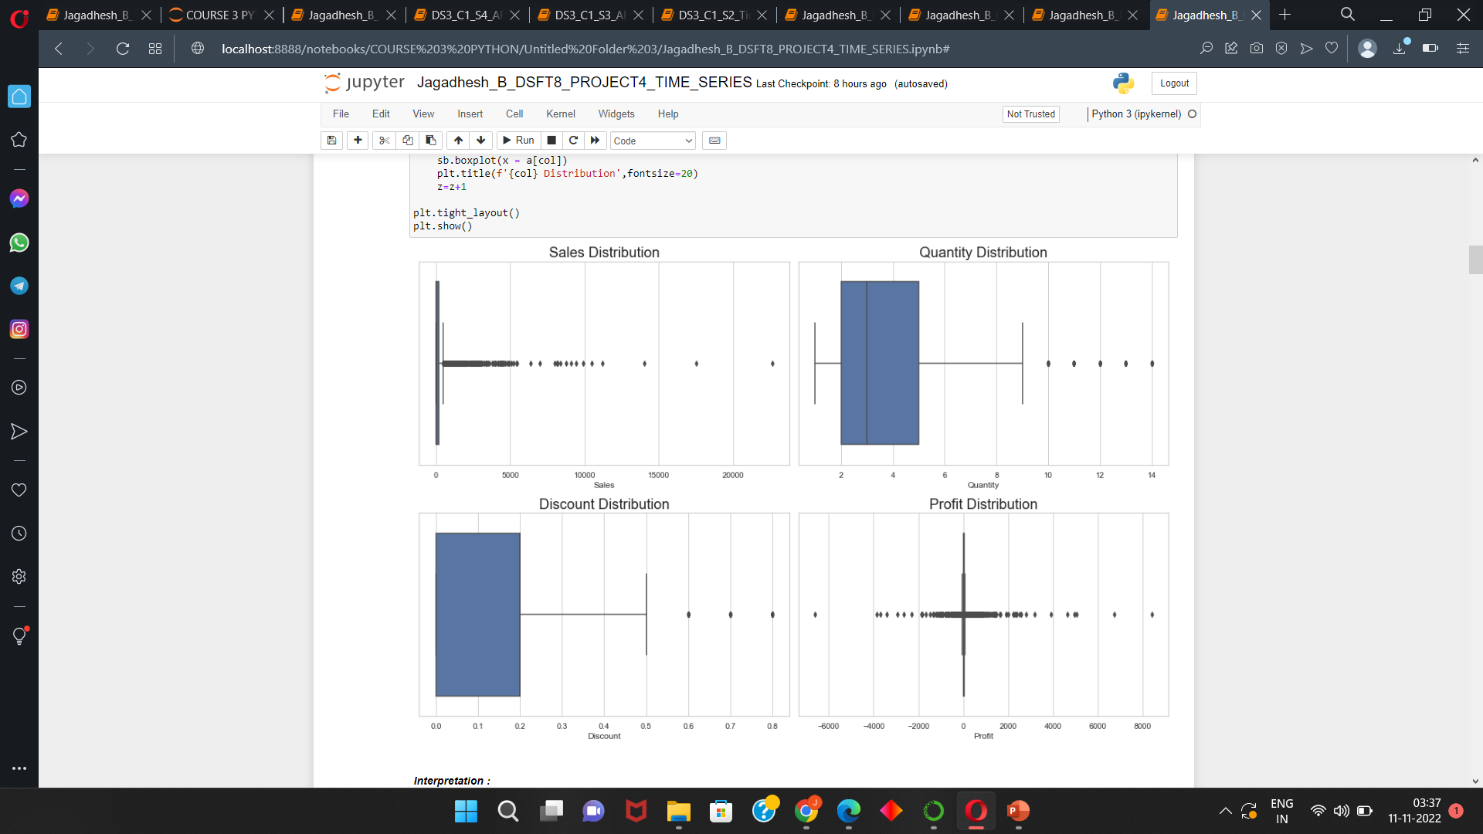
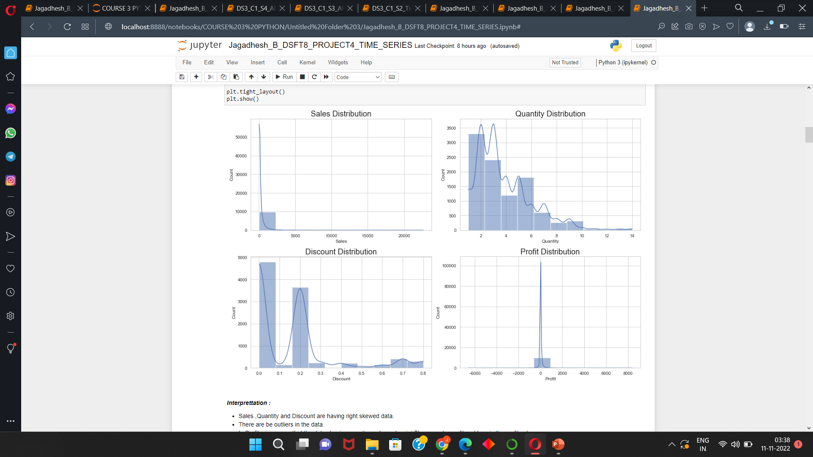
EDA : Univariate, Bivariate and Multivariate Analysis
Sales ,Quantity and Discount are having right skewed data.
There are be outliers in the data.
In Profit we can see that the datas having negative values also ,ie) There can be profit and loss in the profit column.
From the boxplot we can able to see that 'Sales’, 'Quantity’, Discount', 'Profit' are having outliers in the data.

Slide 5
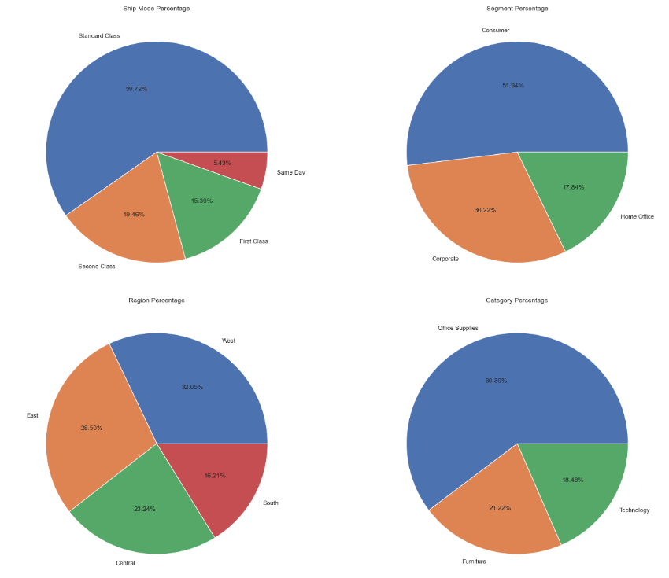
EDA : Univariate, Bivariate and Multivariate Analysis
Percentage of categorical column :
Standard class, cousumer, West, Office supplies are in more percentages in their respective category( 'Ship Mode', 'Segment', 'Region', 'Category']).
The second highest are second class ,corporate ,east, furniture in their respective category.

Slide 6
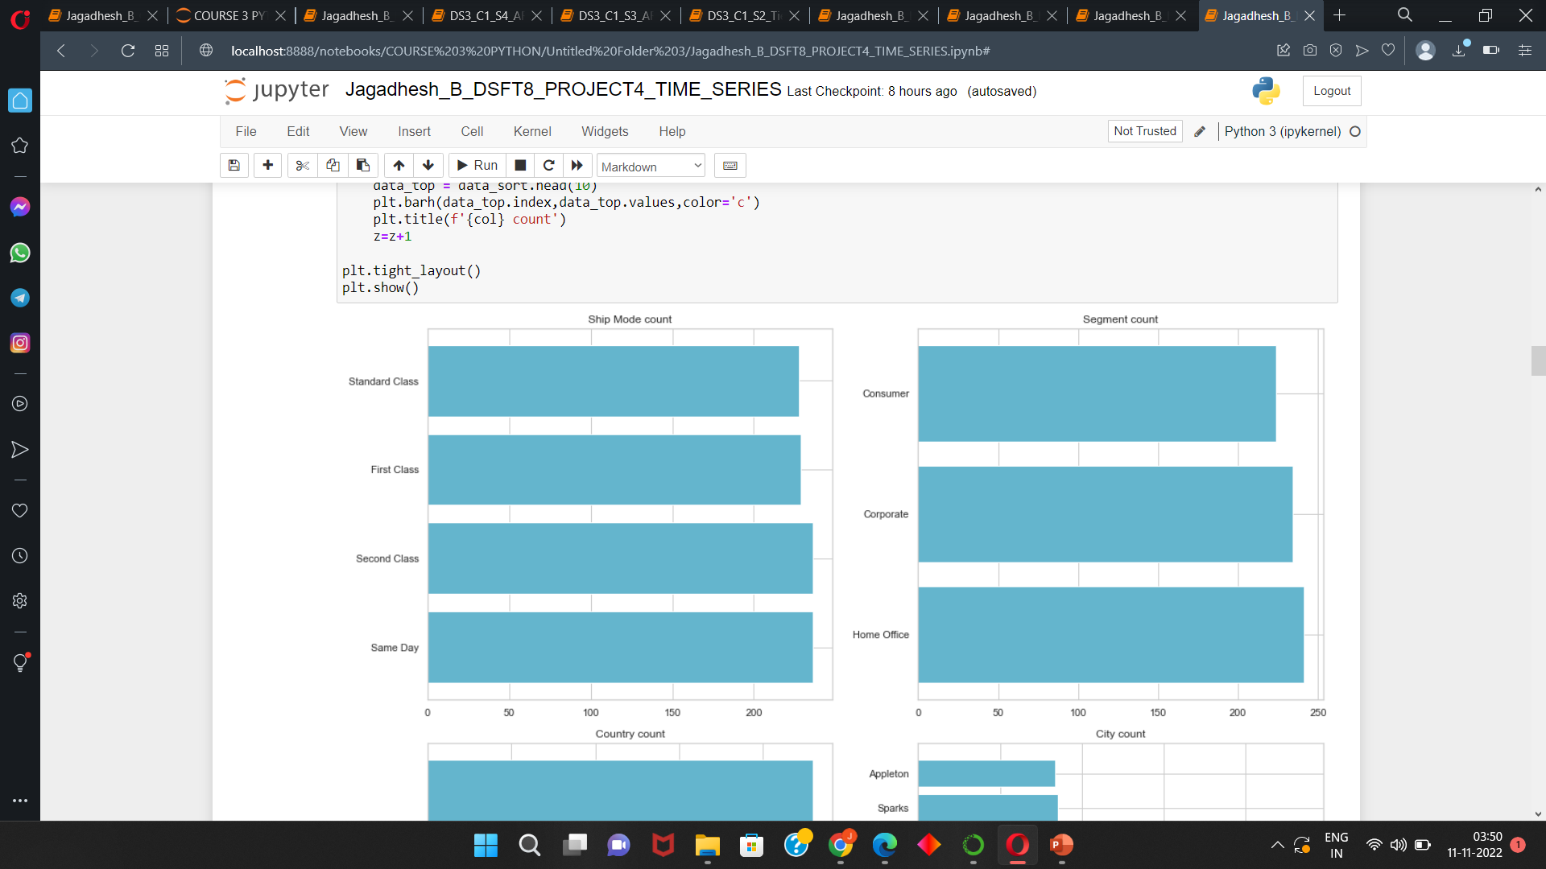
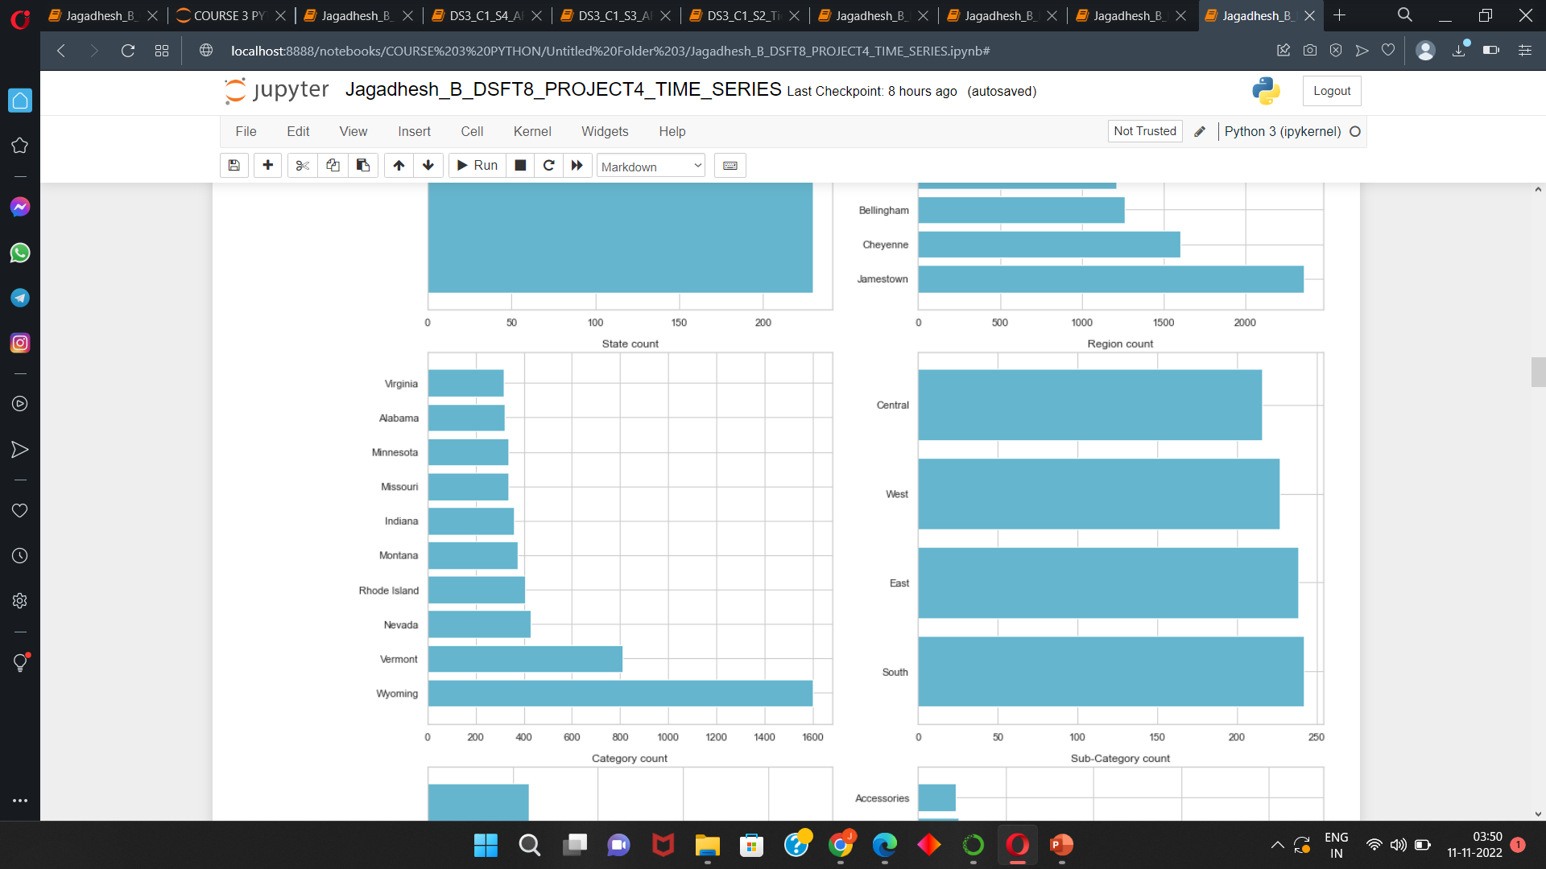
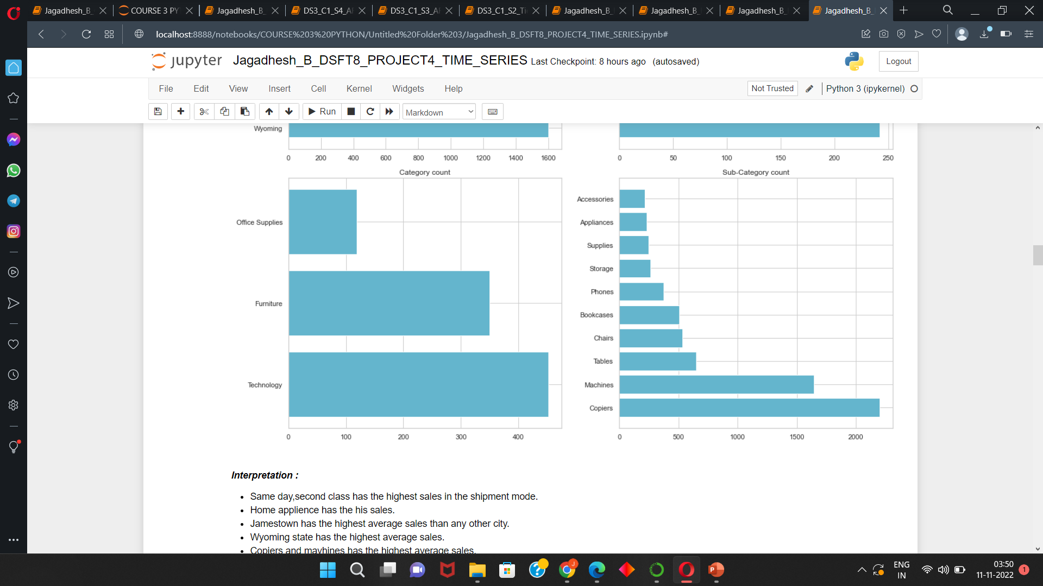
EDA : Univariate, Bivariate and Multivariate Analysis
Categorical Columns respect to sales :
Same day,second class has the highest sales in the shipment mode.
Home applience has the his sales.
Jamestown has the highest average sales than any other city.
Wyoming state has the highest average sales.
Copiers and mavhines has the highest average sales.
In category Technology has the highest average sales.

Slide 7
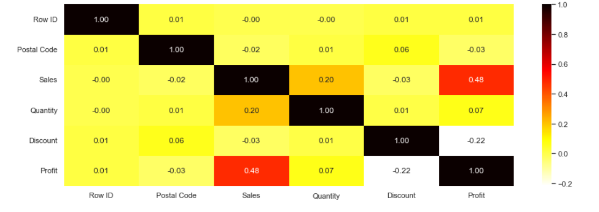
Correlation :
From the heatmap we can see that profit ,quantity has some correlation with each other.
Discount and profit has weak negative correlation.
Except these all are having very weak correlation with each other.

Slide 8
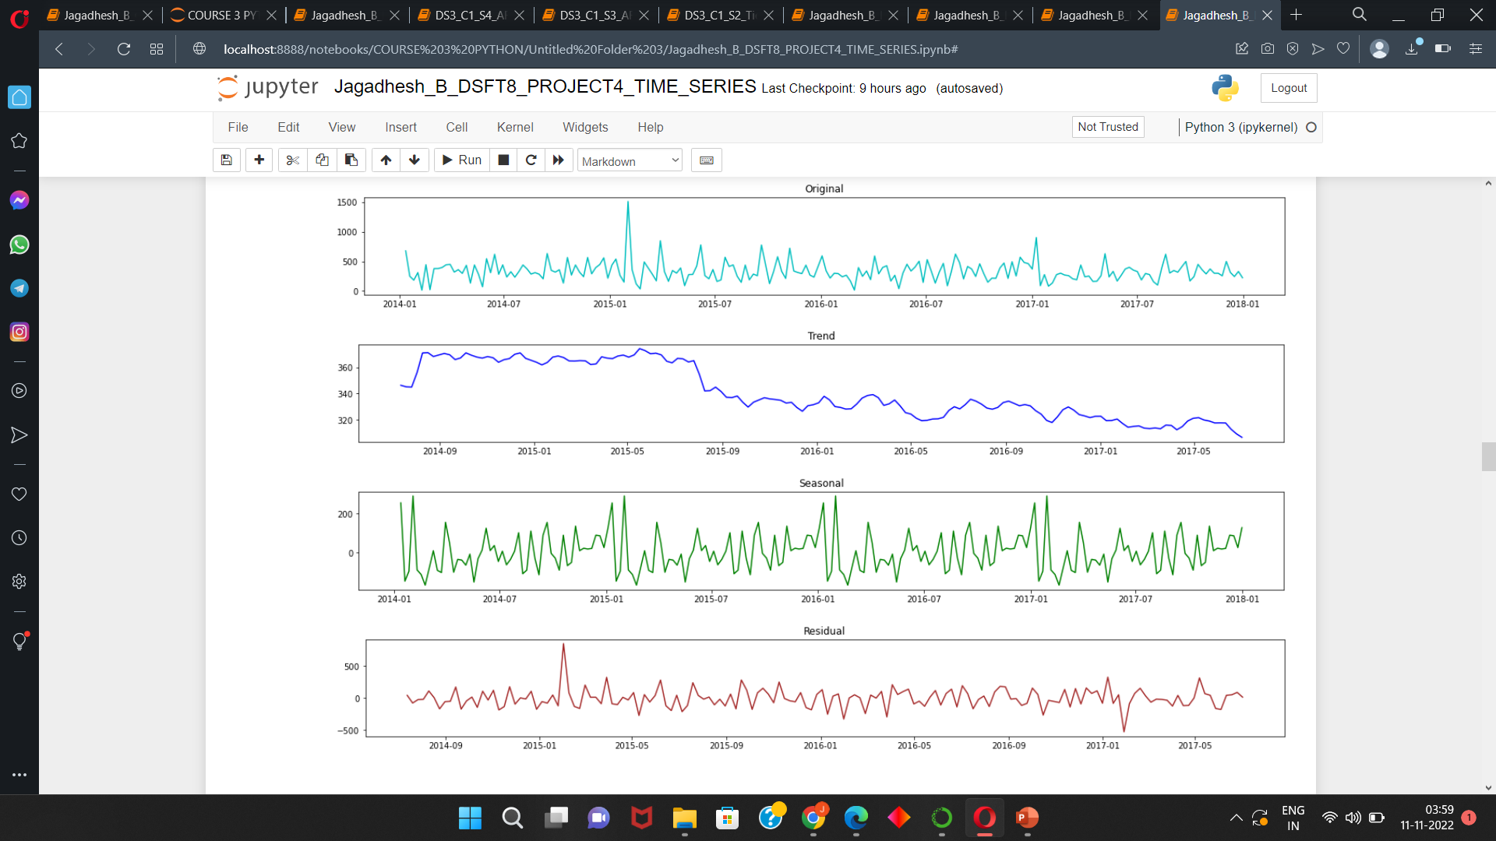
Trend And Seasonality :
From the trend graph we can see some downward trend and the trend is additive.
From the seasonal plot we can able to see some high peaks at a period over every year and some density at each time. Therefore this data also has seasonality
From the Residual plot we can see that error are in straight line ie) This data can be stationary.
This data has both trend and seasonality.

Slide 9
Time Series Models :
The time series models are,
1) ARMA
2) ARIMA
3) SARIMA
4) SARIMAX
For this given data , This data is already stationary so we are comparing ARMA,SARIMA,SARIMAX model for the forecast.
For all the model the hyperparameter are p ,d ,q values. We get those values form ACF and PACF plots

Slide 10
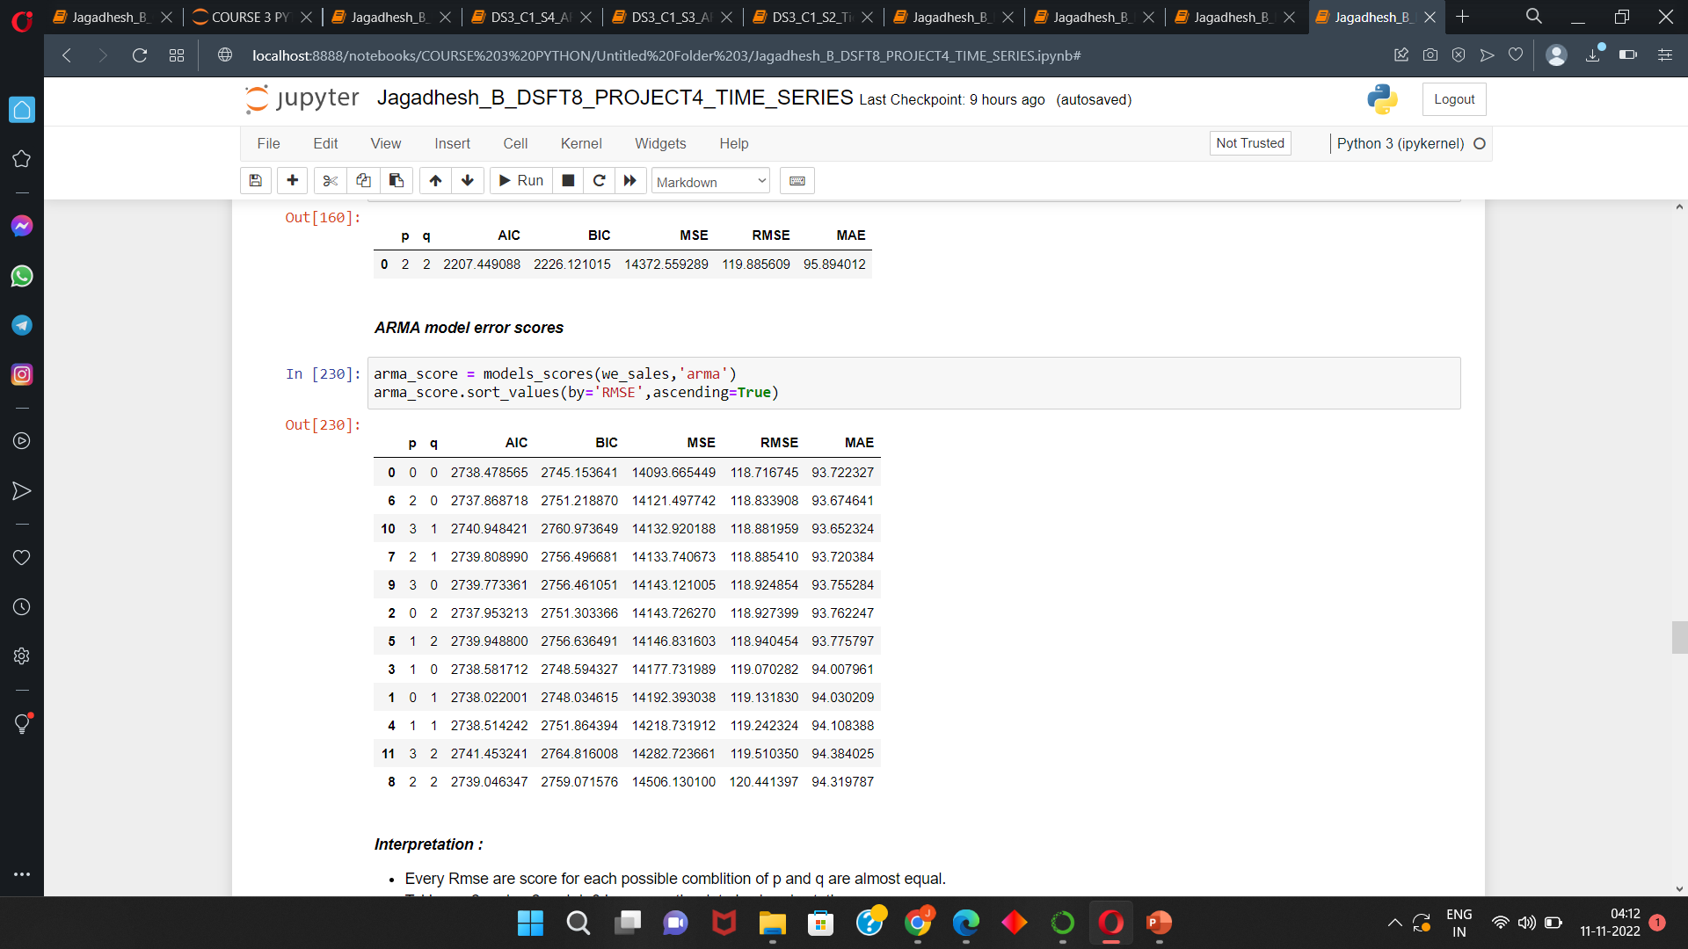
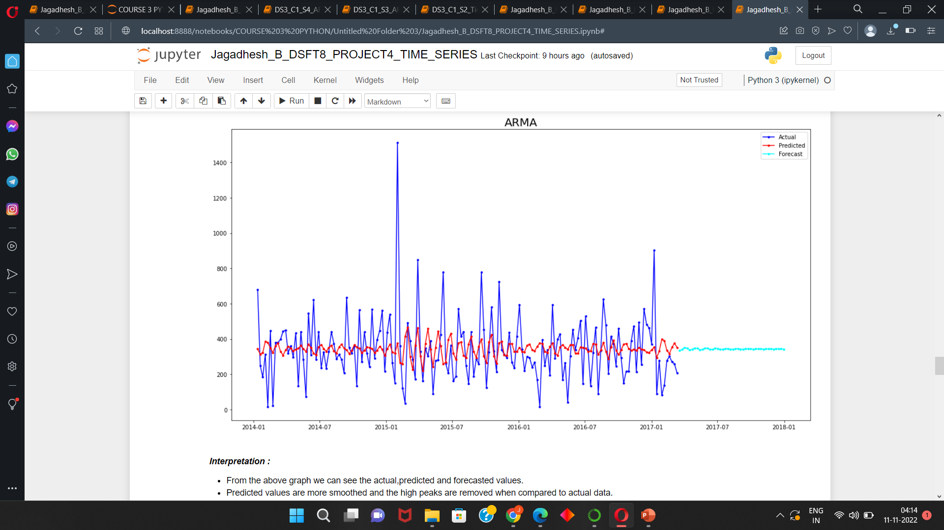
ARMA Model :
Selecting best p and q values by checking the lowest error rate and building and then forecasting the model.
Visualizing the actual and forecasted value,
From the above graph we can see the actual, predicted and forecasted values.
Predicted values are more smoothed and the high peaks are removed when compared to actual data.
But the forecasted data looks not that much good it looks pretty much similar to a straight line but there are some trend we can see

Slide 11
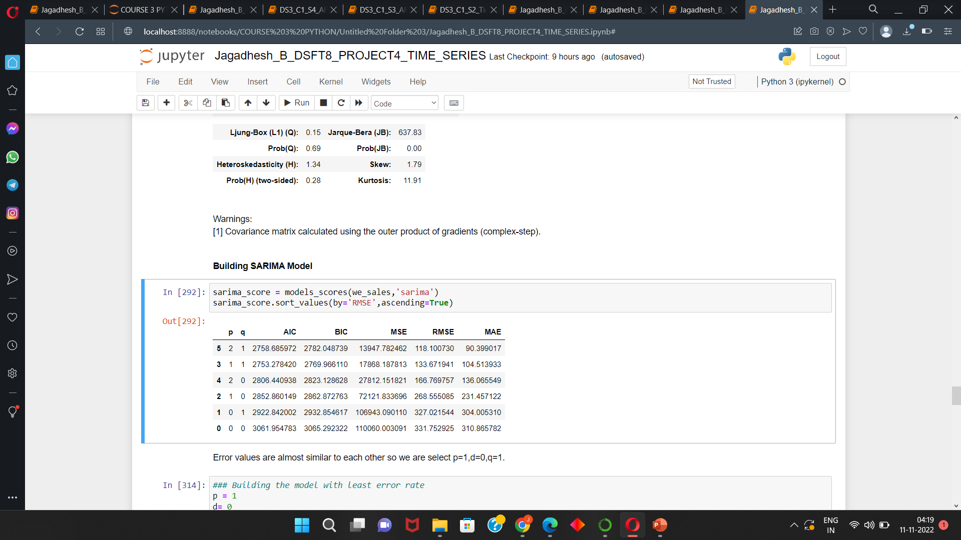
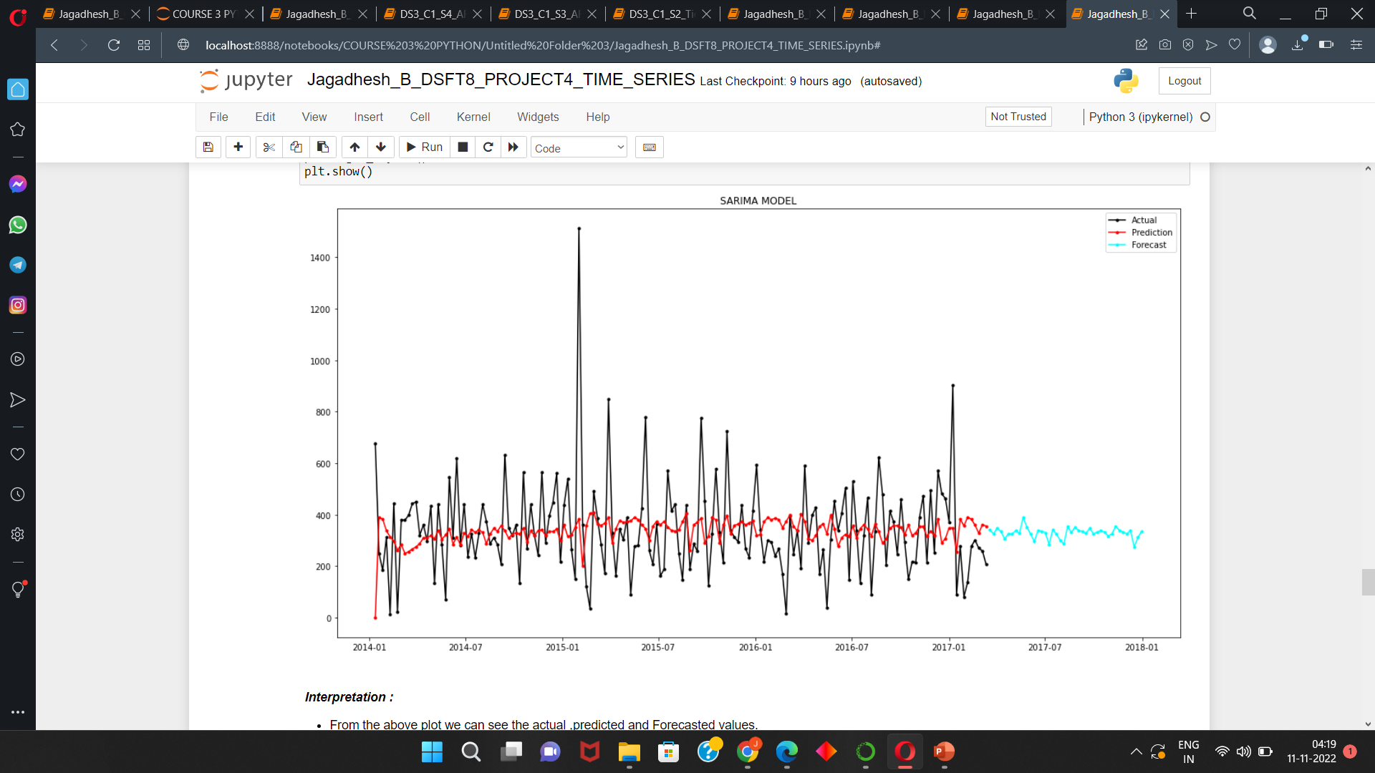
SARIMA Model :
Selecting best p and q values by checking the lowest error rate and building and then forecasting the model.
Visualizing the actual and forecasted value,
The predicted and forecasted values are more smoothened than compared to actual data.
Sarima Forecasted values are good than compared to arma model.
We can see some trend in the forecast data also.

Slide 12
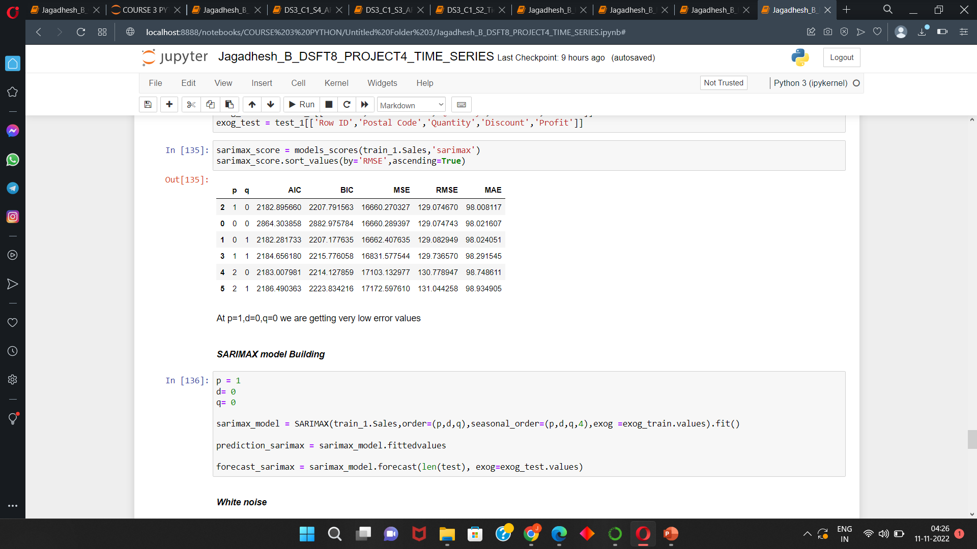
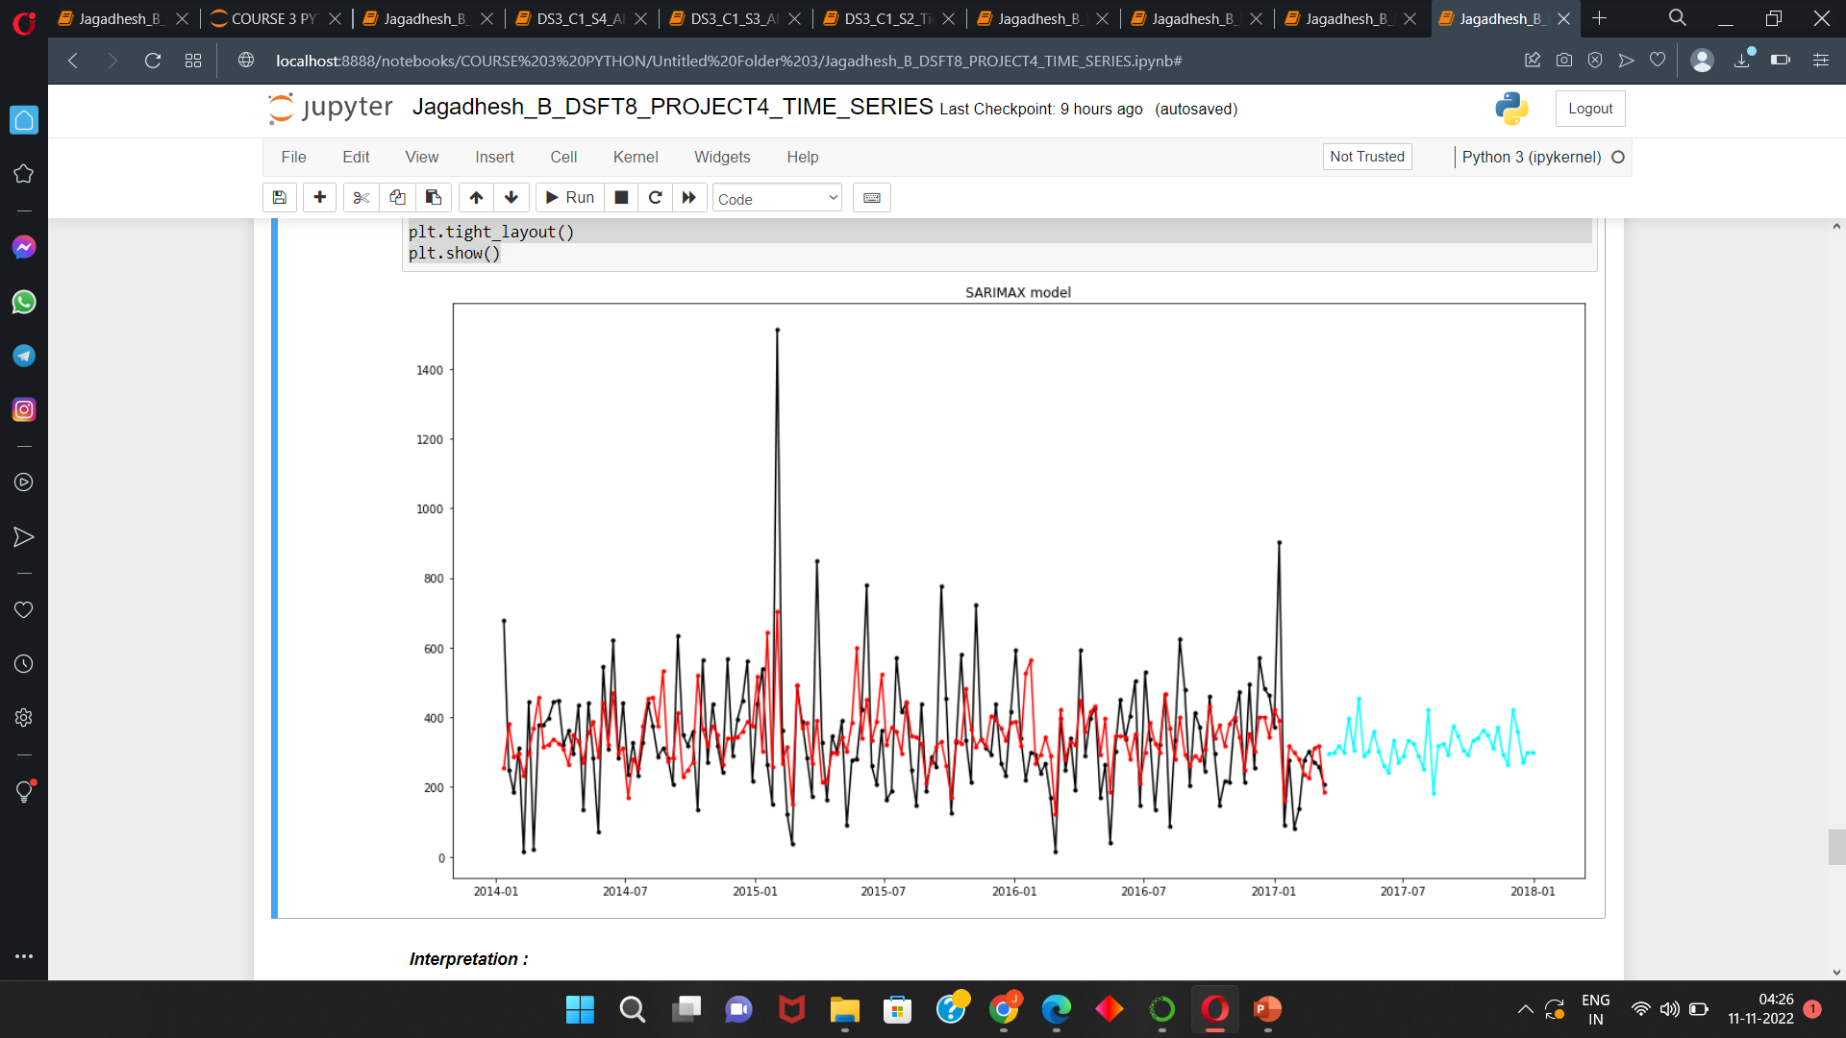
SARIMAX Model :
Selecting best p and q values by checking the lowest error rate and building and then forecasting the model.
Visualizing the actual and forecasted value,
From the above plot we can see the actual ,predicted and Forecasted values.
For sarimax model we are getting good predicted and forecasted values.
The predicted and forecasted data are almost similar and the extreme values are removed from the data.
Sarima model predictions are good than compared to arma and sarima models.

Slide 13
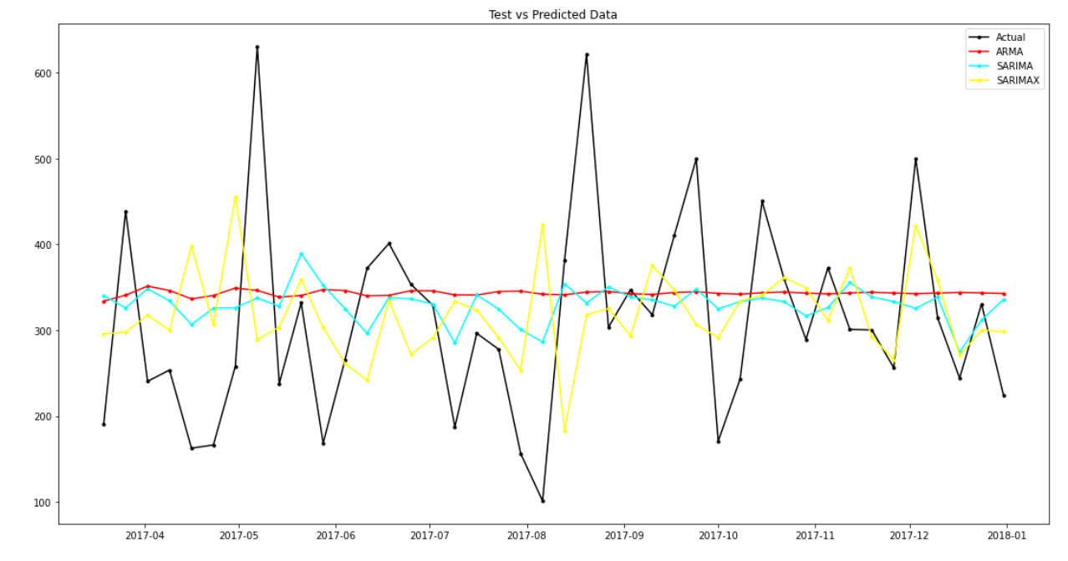
Comparing all the Models :
From the above graph we can see all the forecast from different models.
For ARMA forecast the forecast data looks very straight , So ARMA model is not suitable for this data.
From SARIMA forecast that datas are good but the datas are very smooth compared to actual data. So we SARIMA model is not a suitable model.
SARIMAX model gives good forecasted values than compared to all other models. The values are smoothened and it is little similar to the actual data

Slide 14
Interpretation :
In this we need to forecast the sales of furniture.
The data is in day wise so we have converted it into weekly data.
And we are used arma,sarima,sarimax for the forecast of the data.
By the above analysis arma and sarima are not giving good forecast .
So we are using SARIMAX model for the prediction of sales for furniture.
We are not using ARIMA model because the data is stationary.

Slide 15
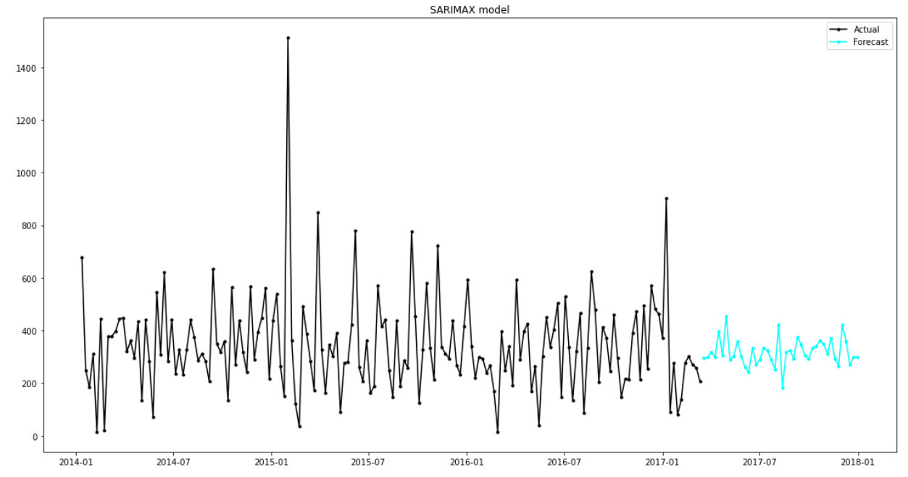
Conclusion :
SARIMAX model giving good results than compared to all model .So we are selecting SARIMAX as the best model.
Business conclusion :
From the above we can say the future forecast for the sales of Furniture.
We can see some upward and downward trend ,from this we can say that the sales was in upward or downward ie) Profit or loss.
By using SARIMAX model forecasted values we can able to say that the sales for the furniture is going to be profit or loss at different time periods.

Slide 16
THANK YOU

